Slide 1
AI-assisted Software Development Trends and Lessons
Don Syme
Visiting Professor, KCL, Principal Researcher, GitHub Next
March 2025
Notes:
Note: Put phone on do not disturb, Slack to not notify, Teams closed
Thank you for the introduction, Rahul. Again, my name is Eddie Aftandilian. I’m a principal researcher in GitHub Next, and today I’ll be sharing some lessons that we have learned from building GitHub Copilots.

Slide 2
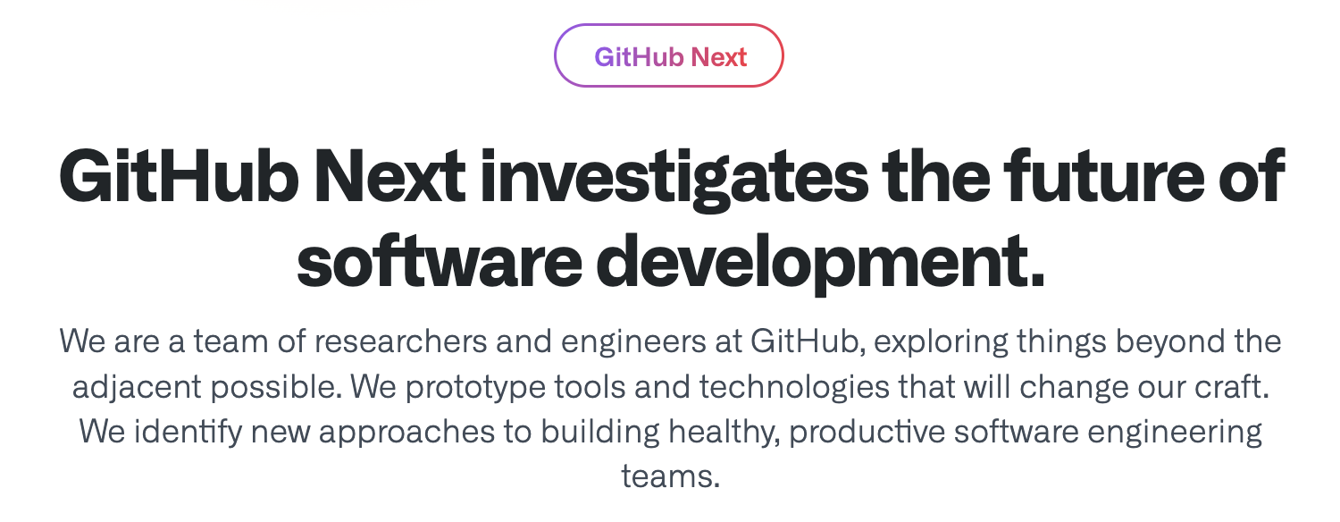
GitHub Next
Research, Build, Ship, Learn

Slide 3
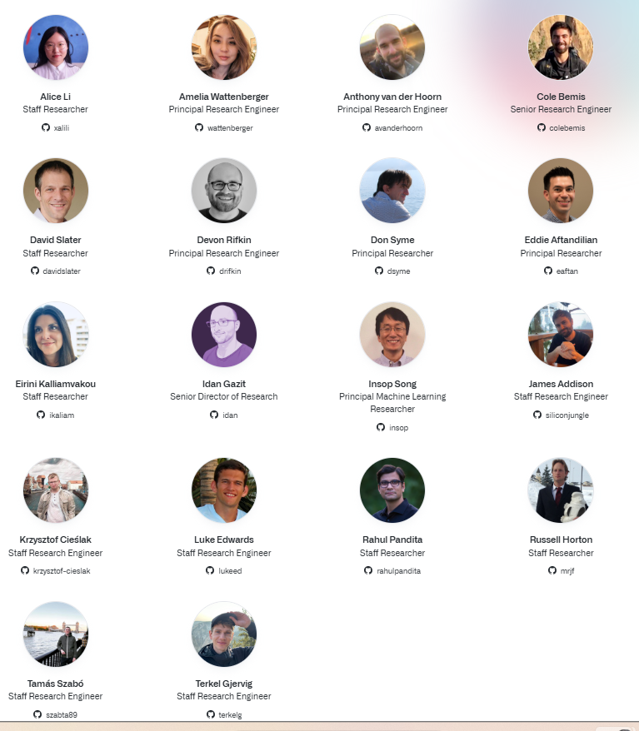
The GitHub Next Team
Notes:
I’m representing the work of an amazing team
Currently 18 people
Mix of backgrounds and skillsets
Frontend, backend, ML, programming languages, user research, etc.
It takes this diverse mix of skillsets to build new AI developer tools

Slide 4
Your Big Questions!
“What will coding with AI look like in the future?”
“Does AI mean that code will be obsolete soon?”
“How should I use AI tools in software development?”

Slide 5

We live in the most incredible of times
AI, indexing and traditional dev tools make us all magicians when it comes to code
But the magic power comes with many difficulties!
Notes:
AI developer tools are changing the way we write software.
GitHub Copilot was one of the first such tools. It launched as a technical preview (essentially a closed beta) in June 2021. Today it has 1.8M paying users, and 50% of those users’ code is written by Copilot. Other companies such as Google report similar proportions of AI-generated code for their comparable AI code completion tools.
This will only increase as the next generation of tools comes online. These are tools that approach the problem at a higher level – for example, completing an entire development task as opposed to completing a line of code or a function
Copilot Workspace, Devin, Cursor, et al.

Slide 6

We live in the most incredible of times
AI, indexing and traditional dev tools make us all magicians when it comes to code
But the magic power comes with many difficulties!
Notes:
AI developer tools are changing the way we write software.
GitHub Copilot was one of the first such tools. It launched as a technical preview (essentially a closed beta) in June 2021. Today it has 1.8M paying users, and 50% of those users’ code is written by Copilot. Other companies such as Google report similar proportions of AI-generated code for their comparable AI code completion tools.
This will only increase as the next generation of tools comes online. These are tools that approach the problem at a higher level – for example, completing an entire development task as opposed to completing a line of code or a function
Copilot Workspace, Devin, Cursor, et al.

Slide 7

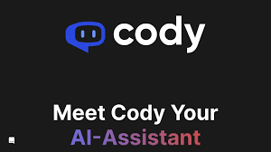

Some Magic Wands

Slide 8
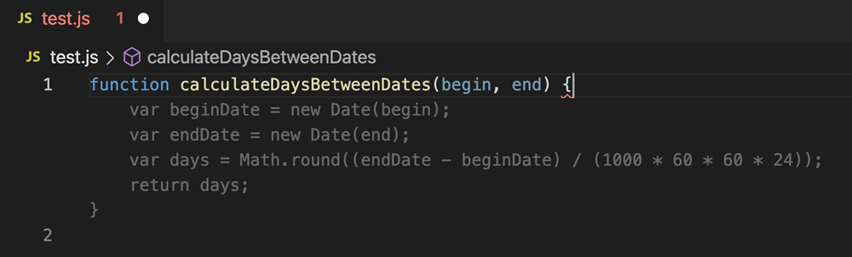
AI code completions
https://www.youtube.com/watch?v=Wk1GVJWt2JA

Slide 9
AI Dev Tools are changing fast
2022: GitHub Copilot launched. Today:
1.8M+ paying users
50%+ of users’ code is written by Copilot
2023: More AI developer tools launched
Summarization, advice, code review
Cody and others
2024: GitHub Copilot Workspace, Cursor Composer, Devin launched
Shift to task-orientation
Cursor Composer brought task-orientation to the IDE
2025: Cursor/VS Code Agent-Mode, Claude Code and others launched
Increases the available automation
2025: Automated app development starts to take off
GitHub Spark, Bolt, Gemini, Lovable, Cogna, …

Slide 10
Where does GitHub Next work?
AI APPLICATIONS & AI DEV TOOLS
AI ENRICHED SERVICES (e.g. indexing, summaries)
FINE TUNING & INFERENCE & GPUS & HOSTING & ….
MODELS

Slide 11
The Big Trends I’m seeing in AI Dev Tooling
AI-assisted Pinpoint Surgery
AI-assisted Task Oriented Surgery
Increasing AI Automation
AI-Assisted App Development

Slide 12
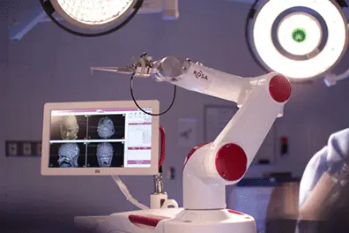
Theme 1: Pinpoint Surgery
Original GitHub Copilot completes code in your editor
You are already located at a pinpoint of change
You accept/reject small bits
You have to type quite a lot
Copilot sort of infers what you are trying to do
This is magical: a finely honed surgical assistant

Slide 13
Other Pinpoint Tools
Type-checking
Autocomplete
On-the-fly checking
Code navigation
Code search
Security checking

Slide 14
Other Pinpoint Tools
Type-checking
Autocomplete
On-the-fly checking
Code navigation
Code search
Security checking
AI Code completion
AI Code summarization
AI code chat
AI Code review
AI Code-fix suggestions
AI Test generation

Slide 15
Theme 2: From Pinpoint Surgery to Tasks
Software activity begins with words and intent Before a code change, before a pull request, there are words - a discussion, a bug report, a feature request, an engineering task, a meeting, a design document, an idea.

Slide 16

Theme 2: From Pinpoint Surgery to Tasks
https://www.flaticon.com/free-icons/
Notes:
The original GitHub Copilot completes code in your editor
You have to accept small bits
You have to move your cursor around
You still have to type quite a lot
Copilot has to infer what you are trying to do
Can we switch POV to whole task, whole change, whole repository
While keeping the key learning of Copilot: repeated AI-user alignment

Slide 17
Theme 2: From Pinpoint Surgery to Tasks
Code 🏆🏆🏆
Idea
https://www.flaticon.com/free-icons/
Notes:
The original GitHub Copilot completes code in your editor
You have to accept small bits
You have to move your cursor around
You still have to type quite a lot
Copilot has to infer what you are trying to do
Can we switch POV to whole task, whole change, whole repository
While keeping the key learning of Copilot: repeated AI-user alignment

Slide 18
Theme 2: From Pinpoint Surgery to Tasks
Change 🏆🏆🏆
Change Intent
https://www.flaticon.com/free-icons/
Notes:
The original GitHub Copilot completes code in your editor
You have to accept small bits
You have to move your cursor around
You still have to type quite a lot
Copilot has to infer what you are trying to do
Can we switch POV to whole task, whole change, whole repository
While keeping the key learning of Copilot: repeated AI-user alignment

Slide 19
Theme 2: From Pinpoint Surgery to Tasks
GitHub Pull Request 🏆🏆🏆
GitHub Issue
https://www.flaticon.com/free-icons/
Notes:
The original GitHub Copilot completes code in your editor
You have to accept small bits
You have to move your cursor around
You still have to type quite a lot
Copilot has to infer what you are trying to do
Can we switch POV to whole task, whole change, whole repository
While keeping the key learning of Copilot: repeated AI-user alignment

Slide 20
Theme 2: From Pinpoint Surgery to Tasks
Changing perspective
Pinpoint Surgery → Whole Operation Single Point of Change → Whole Repository Implicit Task → Explicit Task

Slide 21
Theme 2: From Pinpoint Surgery to Tasks
“Add a refresh button to the main page”
“Create end-to-end tests using Playwright”
“Set up continuous integration using GitHub Actions”
“Set up production resources in Azure using Terraform”
“Read coverage report and add unit tests to repo”
“Create a website for UK house prices”
Notes:
The original GitHub Copilot completes code in your editor
You have to accept small bits
You have to move your cursor around
You still have to type quite a lot
Copilot has to infer what you are trying to do
Can we switch POV to whole task, whole change, whole repository
While keeping the key learning of Copilot: repeated AI-user alignment

Slide 22
Demo - Repo Tasks

Slide 23

Theme 3: Automation with SWE-Agents
SWE-Agents are AI agents that have multiple tools to operate on your code.
Can be unreliable, the “sweet zone” requires skill to find. But improving all the time and competent at some things.
Learn and use them! Don’t let them operate on you!
Notes:
The original GitHub Copilot completes code in your editor
You have to accept small bits
You have to move your cursor around
You still have to type quite a lot
Copilot has to infer what you are trying to do
Can we switch POV to whole task, whole change, whole repository
While keeping the key learning of Copilot: repeated AI-user alignment

Slide 24
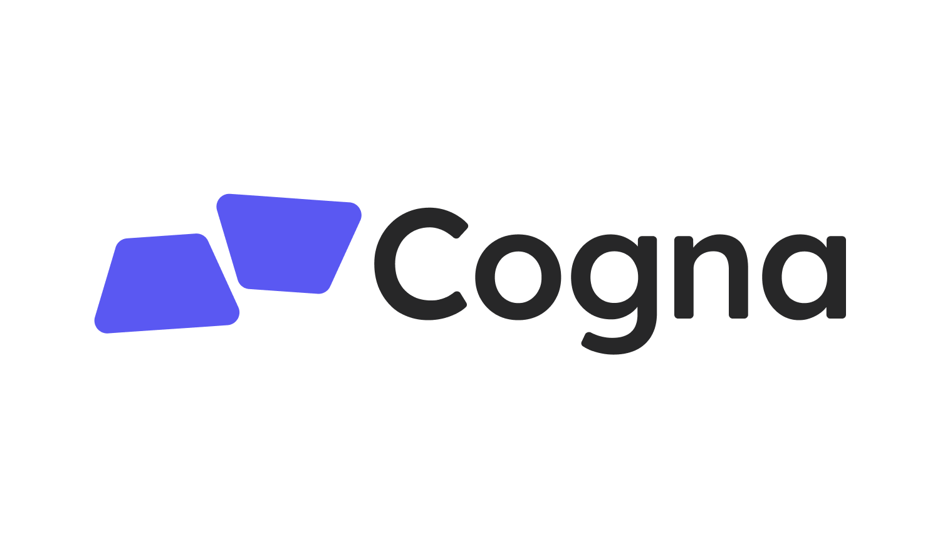

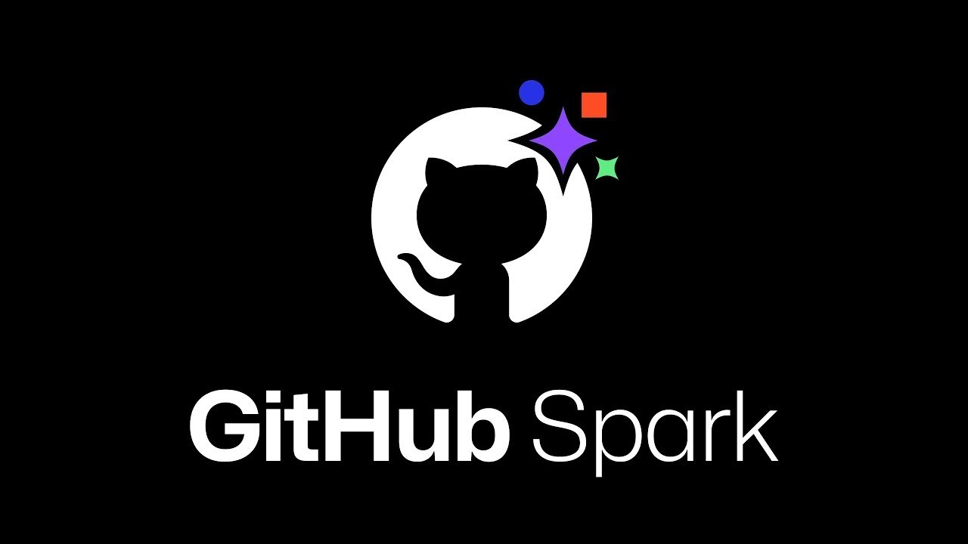
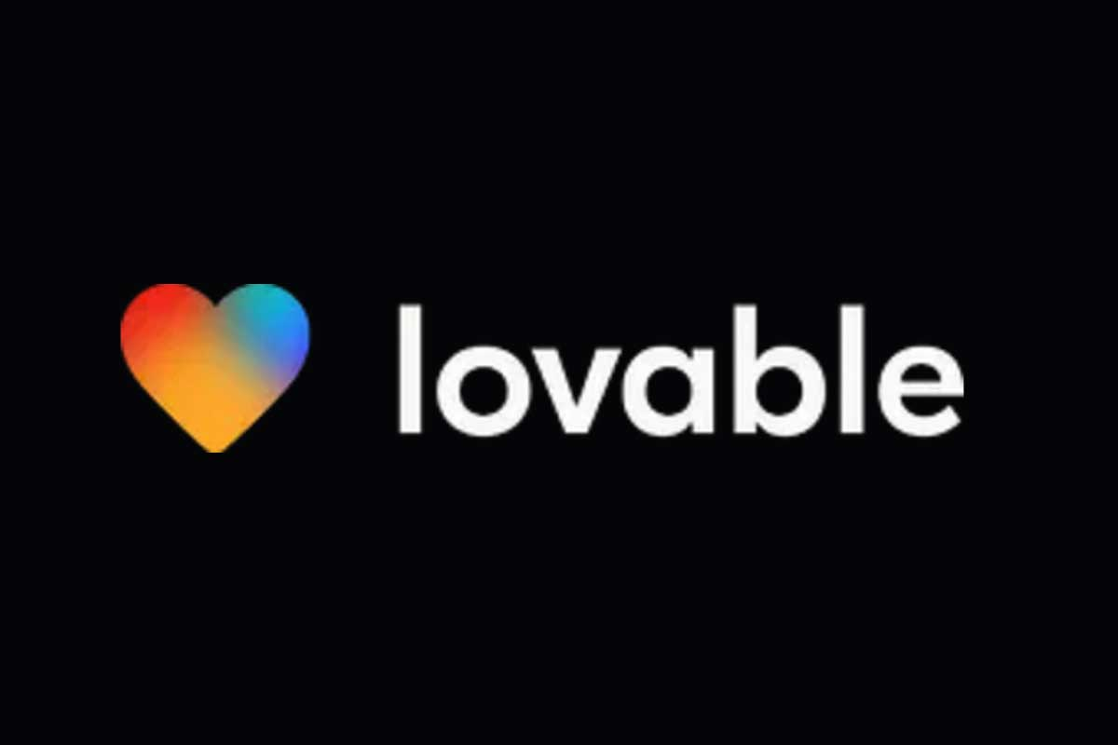

Theme 4: AI-Assisted App Development
“Create me a multiplayer online TicTacToe game”
Notes:
The original GitHub Copilot completes code in your editor
You have to accept small bits
You have to move your cursor around
You still have to type quite a lot
Copilot has to infer what you are trying to do
Can we switch POV to whole task, whole change, whole repository
While keeping the key learning of Copilot: repeated AI-user alignment

Slide 25
Theme 4: AI-Assisted App Development
Narrows the scope to app development
Usually narrows to particular design theme and backend services
The user can run the app and validate directly
Sometimes little need to look at the code at all (vibe coding)
Huge caveats
App coding is replaced by app description
This is a small but important slice of the software industry
Good UX design is subjective, impossible to describe with words
Beware security disasters!

Slide 26
Demo - GitHub Spark

Slide 27
General lessons

Slide 28
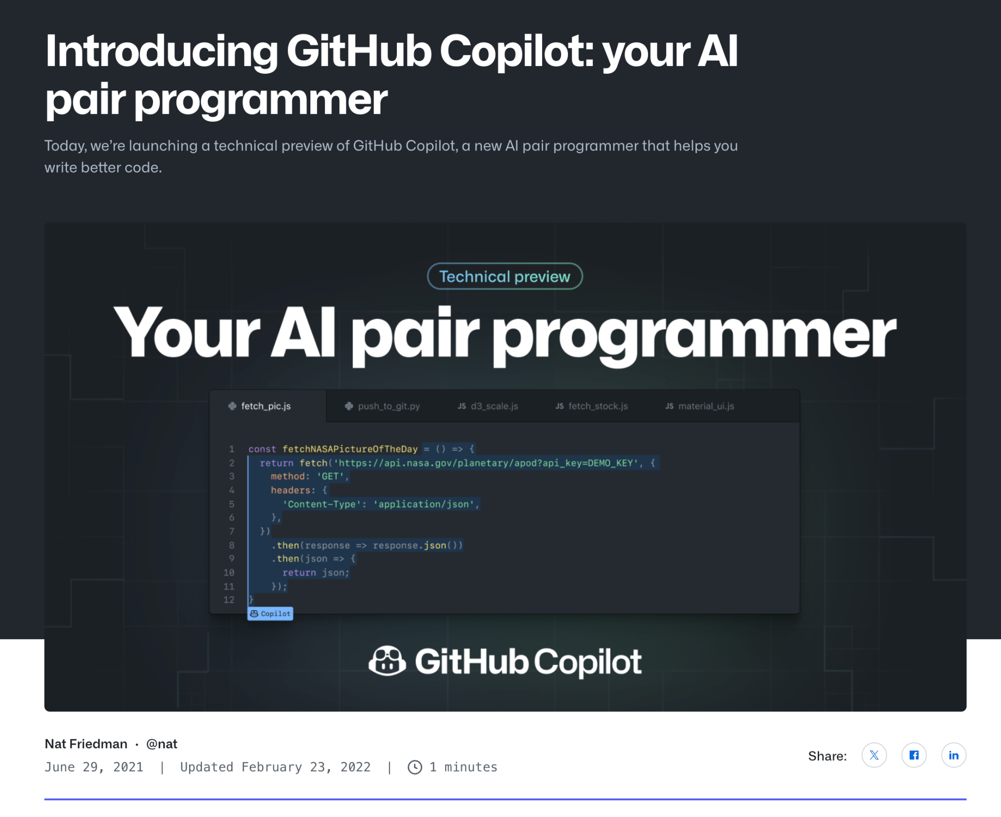
Lesson: A small team can build a big thing
Notes:
I wanted to share the example of original Copilot.
When original Copilot was introduced in June 2021, there were fewer than 10 people on the team. One of the great things about software is that a small team of great people can build something with huge impact. And this is what I meant by “asymmetric value” on the previous slide.

Slide 29
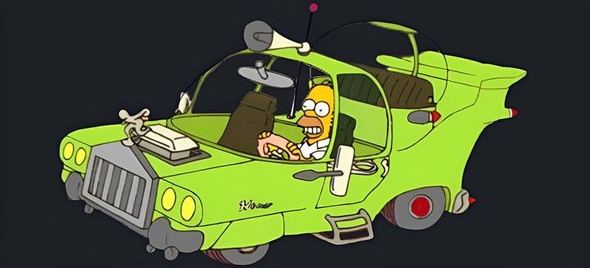
Lesson: Build a prototype ASAP
Notes:
As researchers our instinct is to run benchmarks and quantify things. But “feel” is actually very important when building developer tools, and to get a feel for a tool you have to build a prototype and use it. Also, a prototype is far more convincing to decision makers than benchmarks.
Example: A project from a previous job called Fixbot. I started Fixbot with the aim of automatically repairing code that doesn’t compile using a model trained on source code edits. This was before LLMs, and so we had to train a model to do this. We started by collecting a giant dataset and training that model, then computing the fraction of failed builds we could fix. We could map that to developer time and show huge potential productivity improvements. But my management wasn’t convinced. And it took us years to do all this work. If I could go back, I’d do the least amount of work necessary to build a prototype that we could show to the decision makers, let them use, etc. A usable prototype is much more convincing than charts and graphs, even at a data driven company.
In addition, having a usable prototype lets you test you assumptions. In Fixbot we had some assumptions that made the project significantly more complex. For example, we believed we couldn’t show fixes that wouldn’t compile to developers, and so we did a lot of work to implement speculative builds. But if we had had a prototype, we could have just tried using it before we built that feature, and maybe wouldn’t have been necessary. Or maybe we could find a UI that lowers the cost of incorrect suggestions.

Slide 30
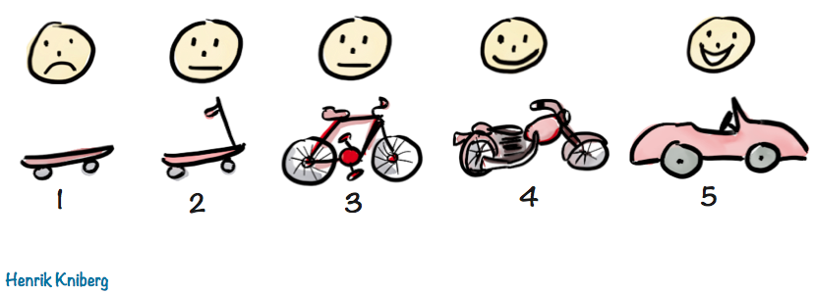
Lesson: Deliver tangible results frequently
Image credit: https://blog.crisp.se/2016/01/25/henrikkniberg/making-sense-of-mvp
Notes:
If you’re thinking big, it can be tempting to talk about multi year time horizons. It’s OK to have a long-term vision and an overarching plan, but you need to drop off useful things regularly, or it’s going to look like you’re doing nothing.
Example: Neural retrieval
In late 2022 we built a homegrown vector database to experiment with. Retrieval was a hot topic in the ML literature and we wanted to see what it might be good for
(More on following slides)

Slide 31
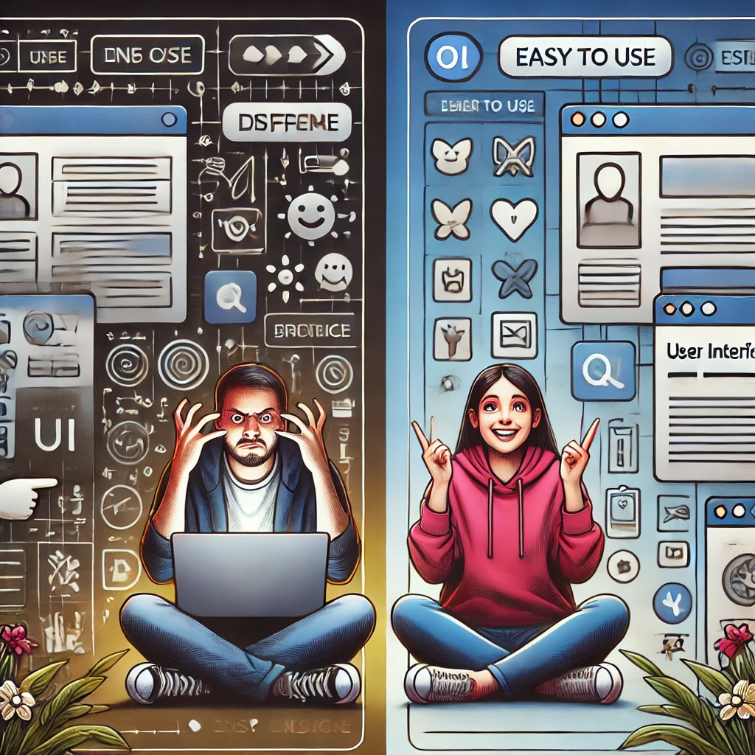
Lesson: UX is critical in AI developer tools
Notes:
In the PL and SWE communities, we have a long history of building really cool, innovative, useful tools that no one uses
Refactoring tools
Static analysis tools
Program verification or formal verification tools
Debugging tools
…. The list goes on and on
This is because we haven’t found the right UX to make these usable by real developers. And usually the people building the tools don’t have UX expertise to find the right UX.
Getting the UX right is the difference between success and failure

Slide 32

Lesson: Beware of long term product-market fit
Notes:
As a research team, your job is to invent new things. Time that you spend maintaining things that you’ve already built is time that you’re not spending building new things.
My teammate Idan Gazit has a saying: “You can’t go exploring if you’re carrying baggage.” If you’ve ever been in the situation of trying to maintain an existing project while building a new thing, you know how hard this is. It’s very difficult to justify spending time on something new and speculative when you have real users who are running into bugs in your existing thing, or who have feature requests that you know will improve their experience.
But as a research team, you have to spend time on the new stuff, because that’s your job. And so it’s very important that you not hang onto projects for too long. You need to get these projects to a point where they can stand on their own, and then hand them off to a product team to own long term.
With original Copilot, this was a long process. Those of us who had created Copilot in Next went on loan into GitHub Engineering to seed and grow the new Copilot team. We helped get Copilot to general availability, we hired people who could take over our work, and we worked on knowledge transfer for almost a year to help build a healthy team that could own Copilot long term. Then we came back to Next and started working on new projects like Copilot Workspace.

Slide 33

Lesson: Don’t over index on cost
Notes:
We’re in an era of exponential improvements in LLMs. This means that costs have been quickly going down, and will continue to do so. And so we shouldn’t prematurely declare projects too expensive, instead we should focus on delivering the most value to the user and assuming exponentially decreasing costs will make it financially viable.
When we built Copilot, there were existing competitors but they were all using small local models, presumably for cost reasons. With Copilot we were aiming for much higher quality, which required a large, cloud hosted model. It would have been easy to just decide this was financially infeasible and kill the project. But instead we focused on building the best tool we could and getting users to love it. And it succeeded! And over time, the models we use to power Copilot have gotten smaller and faster, while quality has improved.
We saw a similar thing with Copilot Workspace. When we started the project, we were using the preview version of GPT-4, which was terribly slow and expensive. But then GPT-4 Turbo came along, which was much faster and cheaper. And now we have GPT-4o, which is quite fast and quite cheap by comparison.

Slide 34

Lesson: Dogfood intensively
Notes:
Dogfooding refers to the practice of using the things you are building. It comes from the phrase, “Eat your own dog food.”
Surprisingly a lot of people don’t do this, or they disregard the dogfood feedback when it’s inconvenient for them
In Next, we dogfood intensively, and we take the feedback seriously. It often results in substantial changes to the things we’re building
(show an example on the following slides)

Slide 35
Your Questions, My Answers

Slide 36
My Answers!
“What will coding with AI look like in the future?”
AI-powered pinpoint tools will be everywhere
AI-assisted task orientation will become normal
Some technical coding will be fully automated and become technical description + exploration
UX design is subjective and will be only partially automated
Requirements, validation, architecture, maintainability, improvement, security will be only partially automated

Slide 37
My Answers!
“Does AI mean that code will be obsolete soon?”
No! Code will largely remain the record of ground truth
Technical description will become more important
Depth knowledge will continue to be critical
Requirements and validation will begin to dominate

Slide 38
My Answers!
“How should I use AI tools in software development?”
Learn to be a great programmer without AI
Embrace many pinpoint tools
Learn task-oriented tools
Play with automation like Claude Code
Play with app-dev tools like Lovable and GitHub Spark

Slide 39
We live in the most incredible of times
Coding is already magical, AI coding gives you wild powers
These powers are not simple to use well
AI is changing coding fast, and good developers embrace some of it
dsyme@github.com @dsyme.bsky.social
Notes:
AI developer tools are changing the way we write software.
GitHub Copilot was one of the first such tools. It launched as a technical preview (essentially a closed beta) in June 2021. Today it has 1.8M paying users, and 50% of those users’ code is written by Copilot. Other companies such as Google report similar proportions of AI-generated code for their comparable AI code completion tools.
This will only increase as the next generation of tools comes online. These are tools that approach the problem at a higher level – for example, completing an entire development task as opposed to completing a line of code or a function
Copilot Workspace, Devin, Cursor, et al.

Slide 40

GitHub Next
Investigating the future of software development
githubnext.com

Slide 41
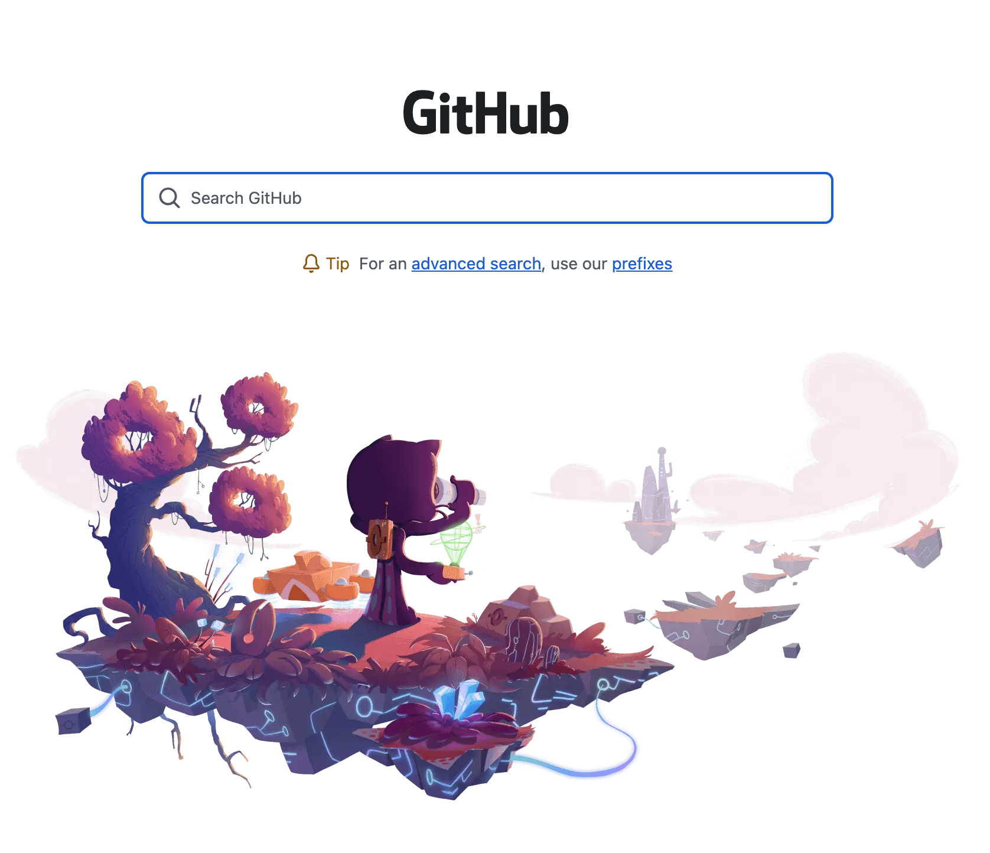
Retrieval application 1: NL code search
Notes:
We first used it to explore natural language code search, with a deliverable of a live demo at the GitHub Universe conference in Oct 2022
While it demoed well, the quality of the search results wasn’t good enough for a real product. So we moved on to another application.

Slide 42
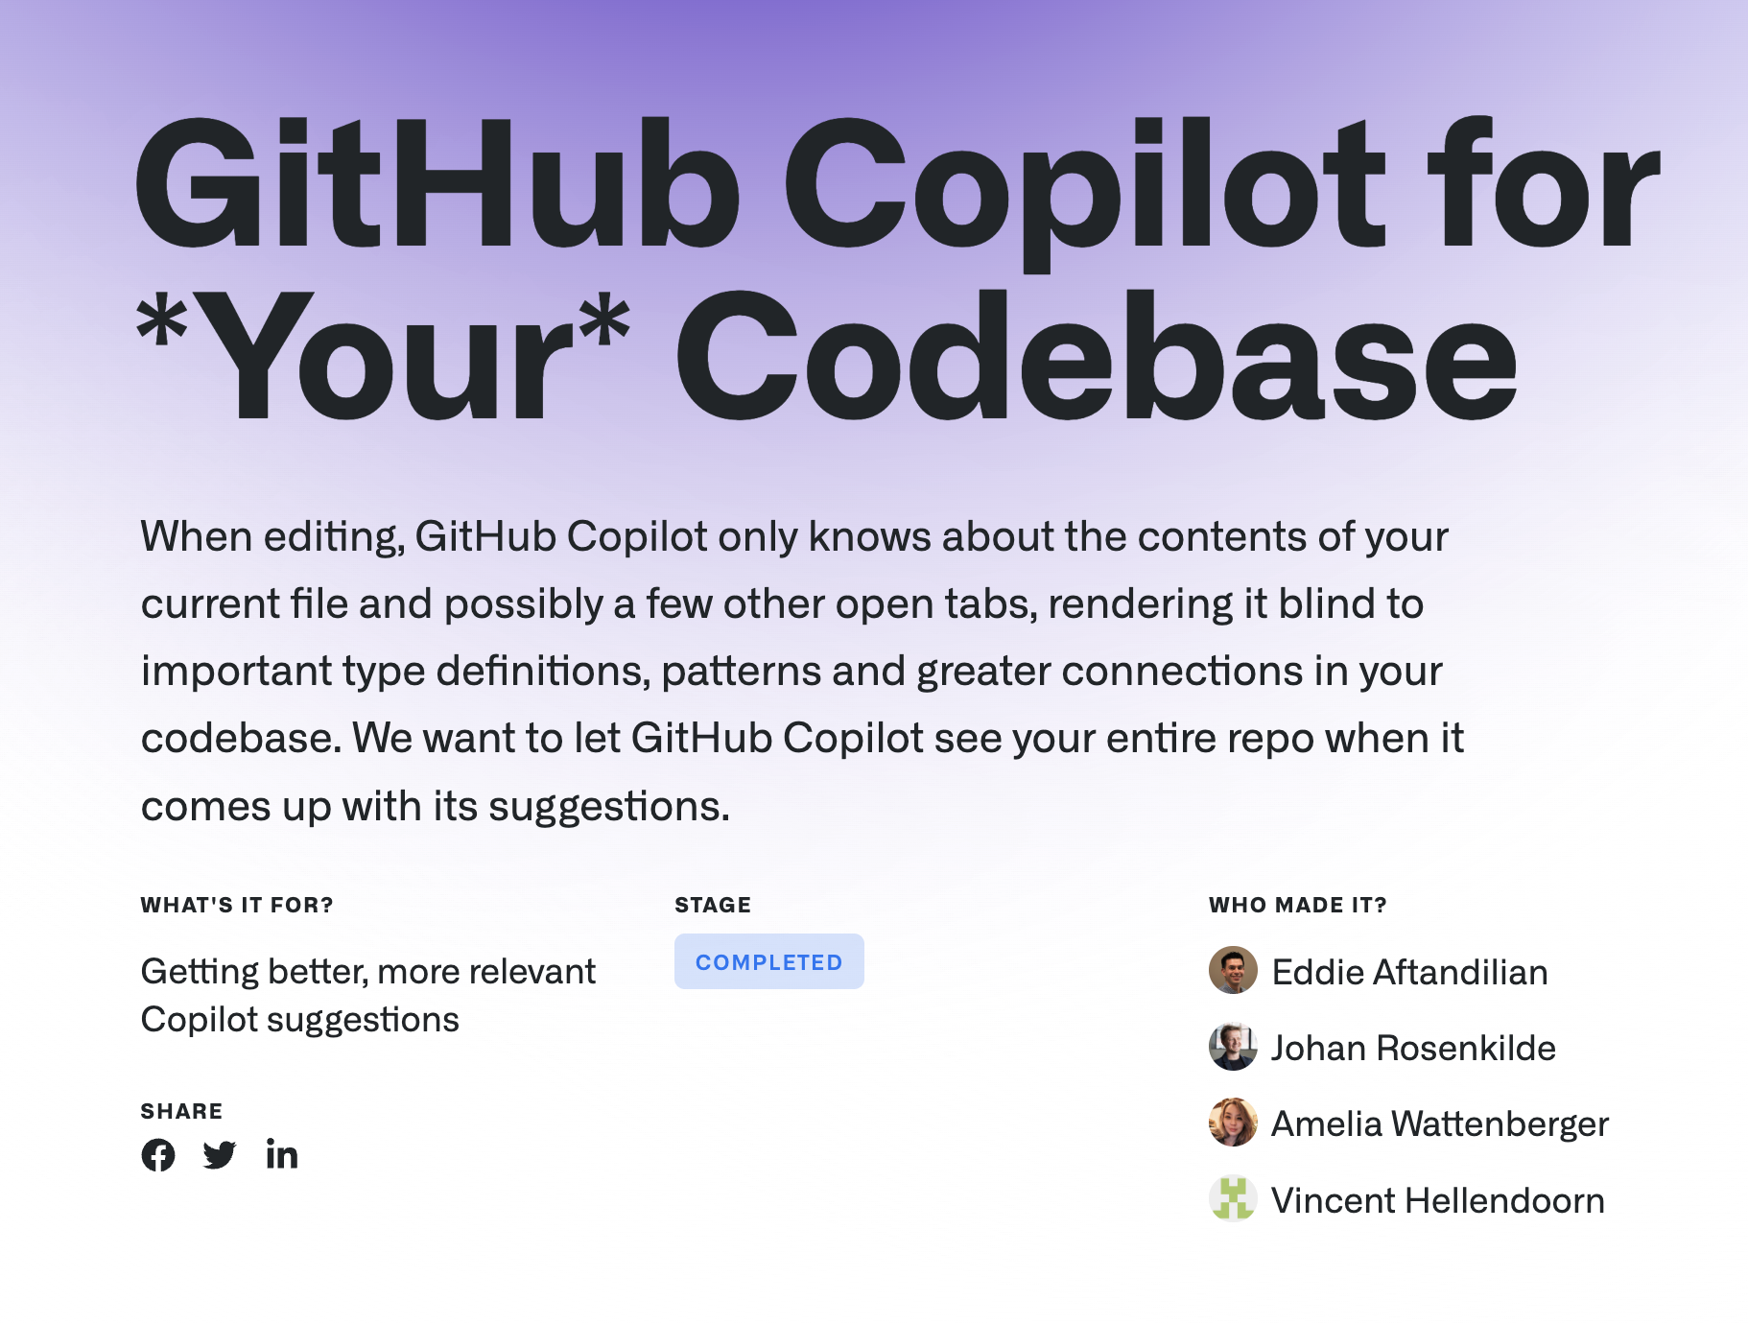
Retrieval application #2: customized Copilot
Notes:
Then we used it to experiment with customizing Copilot for private codebases. Because Copilot uses standard models that were trained on public code, they are not aware of a company’s private code, internal APIs, custom programming languages, etc. And so we were looking for a solution to improve quality on these private codebases.
One way to do this is to index the private codebase and store snippets in a vector database, and then as the user is typing you query the database for similar code and inject it into the prompt.
So we implemented this, and we ran on an offline evaluation and got a very positive result. But when we ran an online A/B test in Copilot, we didn’t see any improvement in our key metrics. And we had another application for retrieval, so we handed this result and our code to the Copilot team, and moved on.

Slide 43

Retrieval application #3: Copilot for Docs
Notes:
By this time, ChatGPT had been released, and everyone was excited for chat.
We realized that you could use retrieved snippets to ground an LLM chatbot in high quality, official documentation
We also realized that you could retrieve from private documentation as well as code, to customize the chatbot for a specific company
So we refocused on retrieval-augmented chat, which turned into Copilot for Docs, which launched as a tech preview in Mar 2023
With the retrieval work, we were able to deliver 3 useful things, each taking a few months, along on the theme of investigating neural retrieval

